Slide 1
Web Application Penetration Testing
Frugal
v
BSides 2017

Slide 2



Who are we?
Information Security Consultants
Web Application Penetration Testers
Padawan Hackers
Harshal Chandorkar
Natalia Wadden

Slide 3
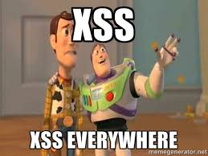
How did we get here? Take a ride with us…

Slide 4

Lone Soldier
Penetration tests executed by vendors include:
Severity ratings
Risk ratings
Scope
False positives
Quality and POC
Cost
Let’s see if we can go head to head:
Execute pentest
Adjust ratings/risks
Capture full scope
Eliminate false positives
Provide POCS

Slide 5


Readying the Army on a Shoestring Budget
Interest
Desire to Learn
Perseverance
Technical Skills Assessment
Training:
Open-Source: FREE (e.g. DVWA, Mutillidae, metasploitable, Security Shepherd)
Day-to-day technical challenges (e.g. incident handling, etc.)
Hand Holding

Slide 6

Maturing the Program
Inventory of your Web Applications
Planning
Information Gathering
Execution of Pentests
Reporting
Artifacts
Metrics for Sr. Management

Slide 7

The Dirty Talk About Time & Money

Slide 8
Security Testing Methodology Life Cycle
Planning
Gathering Information
Discovering Vulnerabilities
Reporting
Findings Walkthrough
Working with the project team/support team to clearly define scope and rules of engagement
Obtain written approval
Confirm timing and agree on a schedule

Slide 9
Security Testing Methodology Life Cycle
Planning
Gathering Information
Discovering Vulnerabilities
Reporting
Findings Walkthrough
Collecting and examining key information
Environment Walkthrough
Review prior test results if available
Environment Walkthrough
Obtain Credentials if required

Slide 10
Security Testing Methodology Life Cycle
Planning
Gathering Information
Discovering Vulnerabilities
Reporting
Findings Walkthrough
Finding existing vulnerabilities using manual and automated techniques
OWASP Top 10
Company Specific
Business Logic

Slide 11
Security Testing Methodology Life Cycle
Planning
Gathering Information
Discovering Vulnerabilities
Reporting
Findings Walkthrough
Providing high level findings, detailed report and POC evidence
Portswigger Burp
Logs
SQL Map
XSSer

Slide 12
Security Testing Methodology Life Cycle
Planning
Gathering Information
Discovering Vulnerabilities
Reporting
Findings Walkthrough
Walkthrough where findings were found
Demonstrate how bad it can be

Slide 13
Webapp Pentesting Tools
Frequently used:
Portswigger BurpSuite Professional
SQLMap
Supplemental:
XSSer
Nikto
OWASP Zap

Slide 14
A Few Burp Extenders That We Use
CO2
Active Scan ++
CSRF Scanner
Code DX
Logger++
Software Vulnerability Scanner
Software Version Reporter

Slide 15
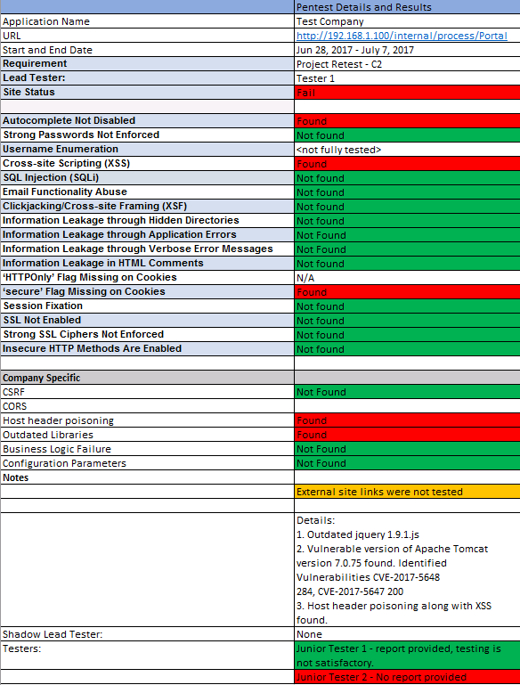
Webapp Pentest Report

Slide 16
Webapp Pentest Report

Slide 17
Sample: Webapp Pentest Framework based on OWASP Top 10
Web Methods
Did the tester note the site allows basic web methods (e.g. “PUT, GET, POST, HEAD, OPTIONS, DELETE”)?
Reflected Cross-site Scripting
Did the tester input a payload?
What was the result? Reflected?
Did the tester view the source?
Clickjacking/Cross Site Framing (XSF)
X-Frame-Option – set to Deny or Same-Origin?
HTML iframe POC create? Successfully loaded into the site?
CSRF
Is the token randomly generated?
Did the tester note if CSRF is noted on a GET request?
Did the tester create an POC HTML file to execute on the site?
Was the file successfully loaded on the site?

Slide 18
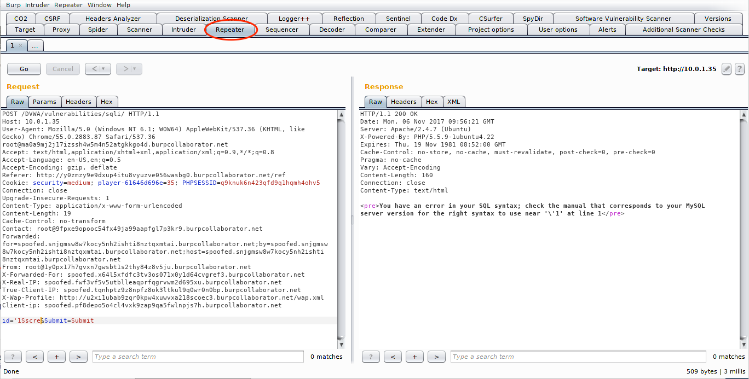
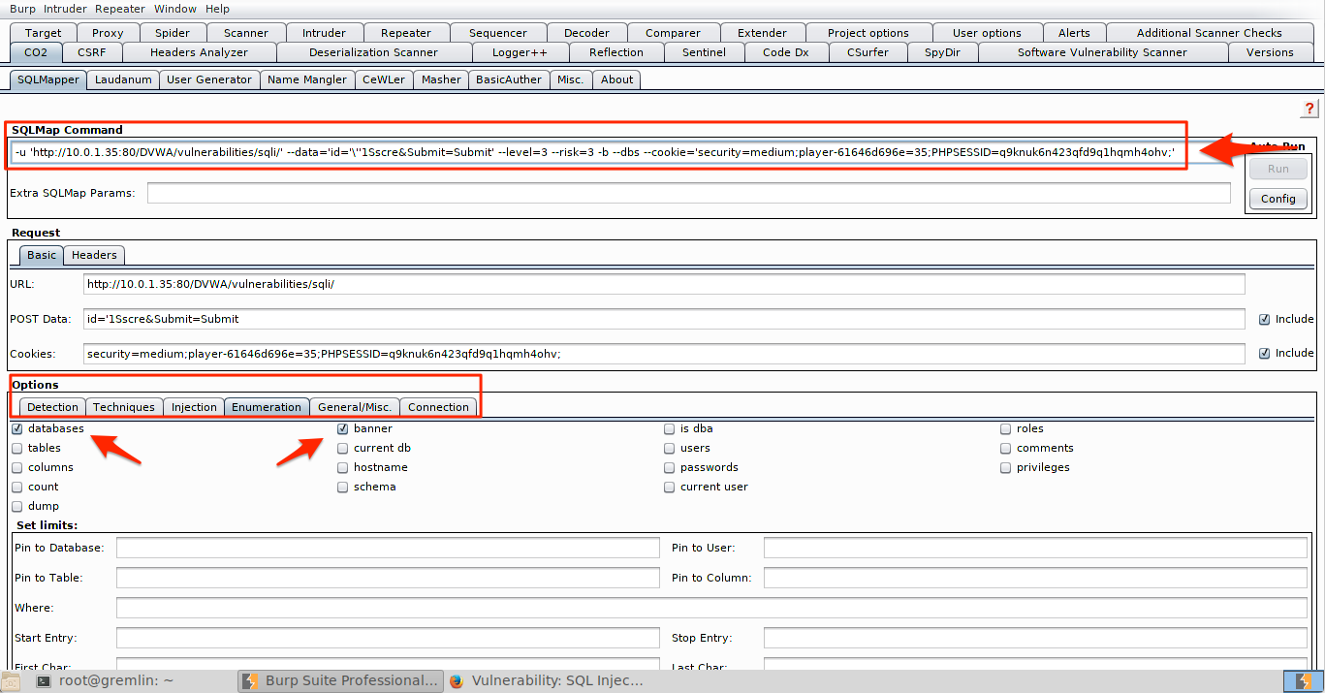
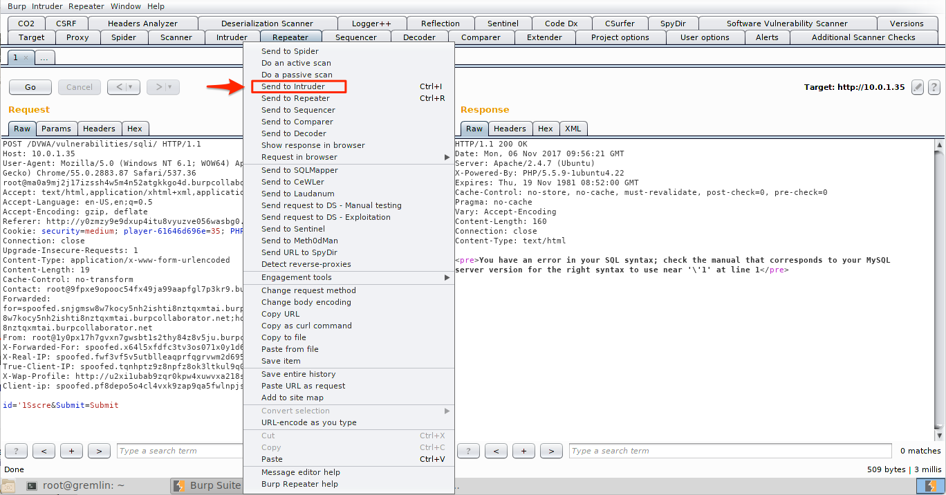
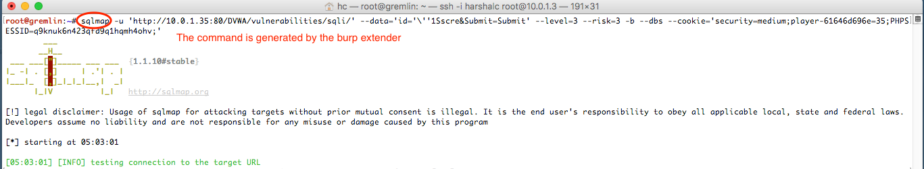
Leveraging Burp Extenders With Other Free Tools

Slide 19
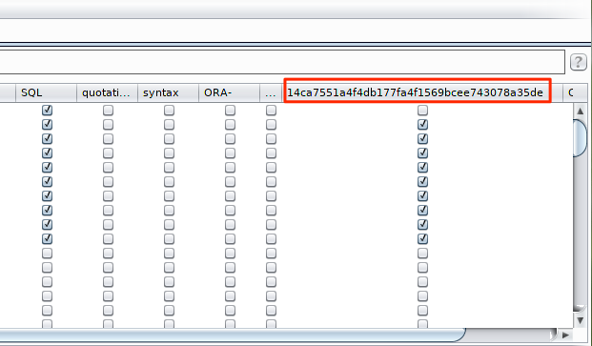
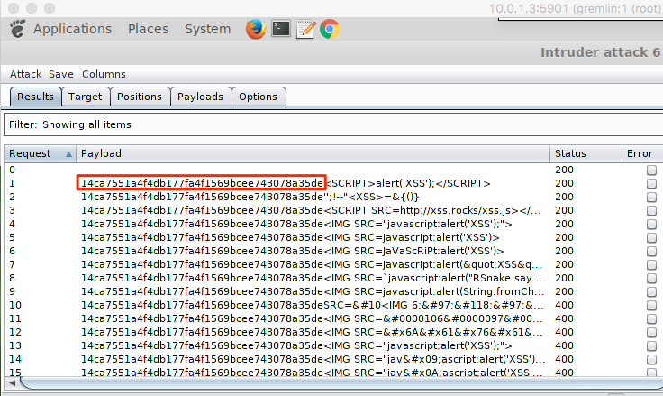
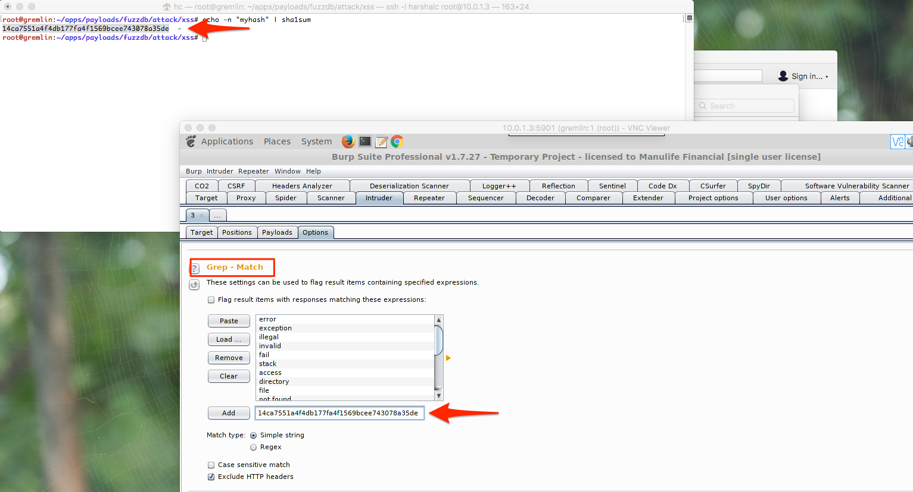
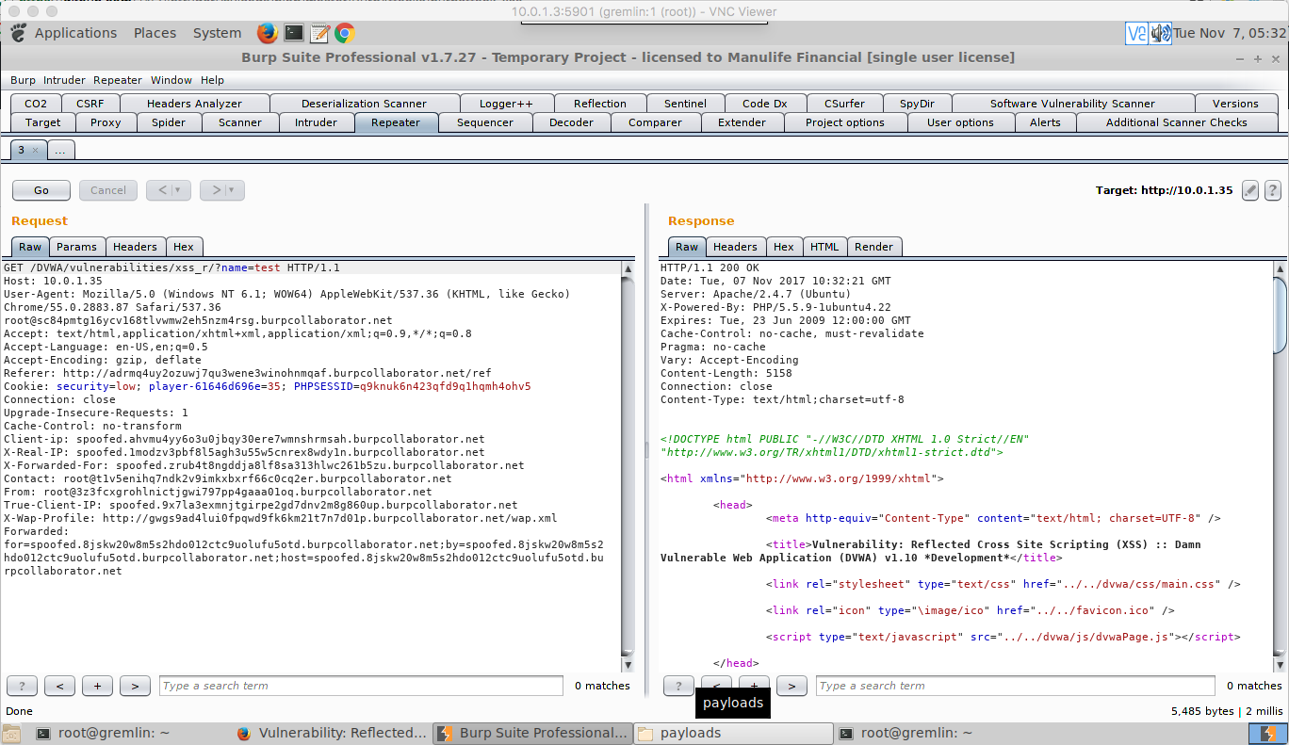
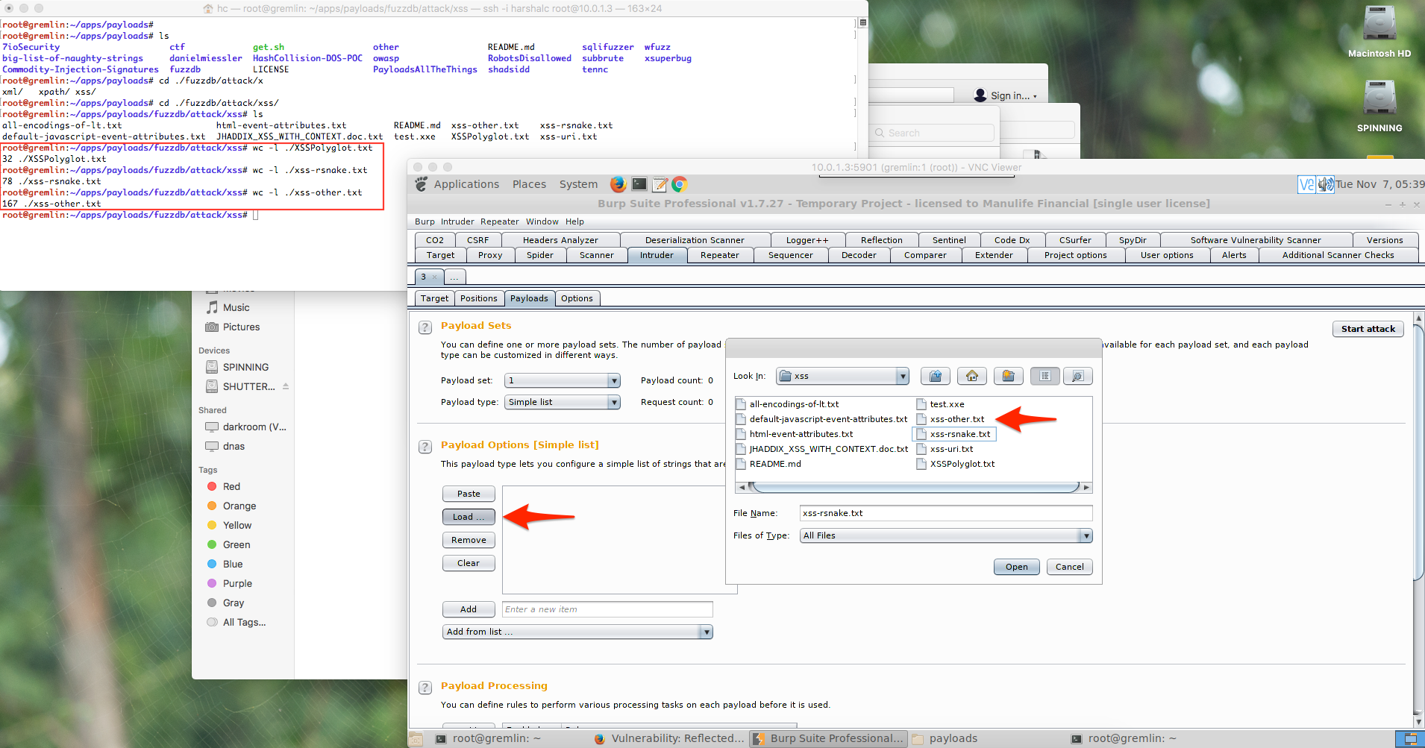
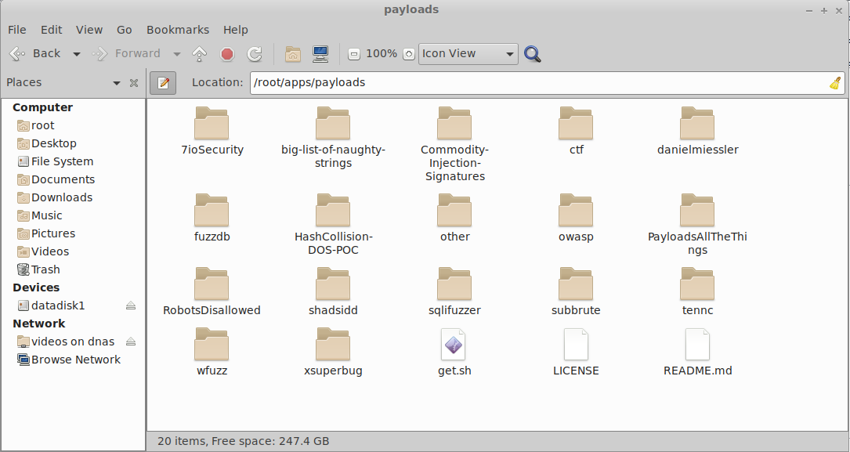

Slide 20

Incidents happen, but is it fair to blame us?
Understand the incident
Review all evidence presented
Obtain testers logs
Provide proof
Understand impact

Slide 21
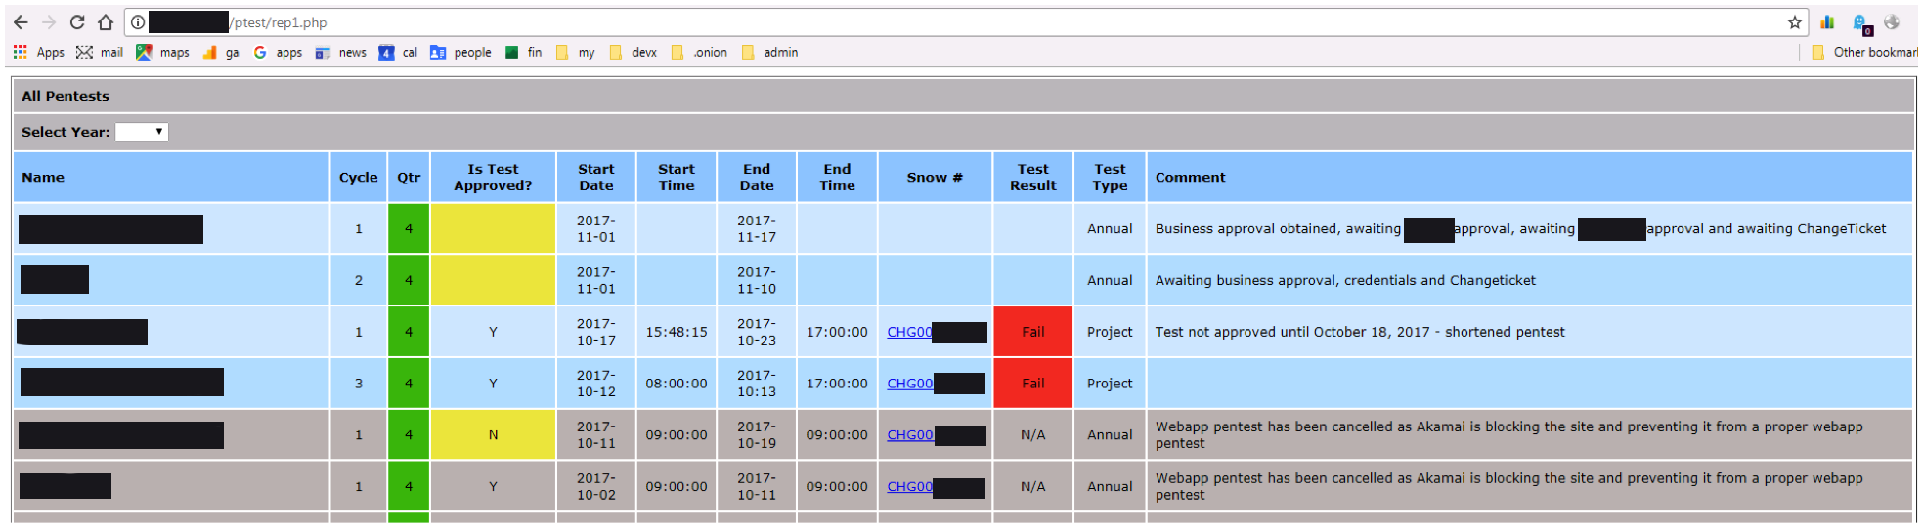
Webapp Pentest Tracking

Slide 22
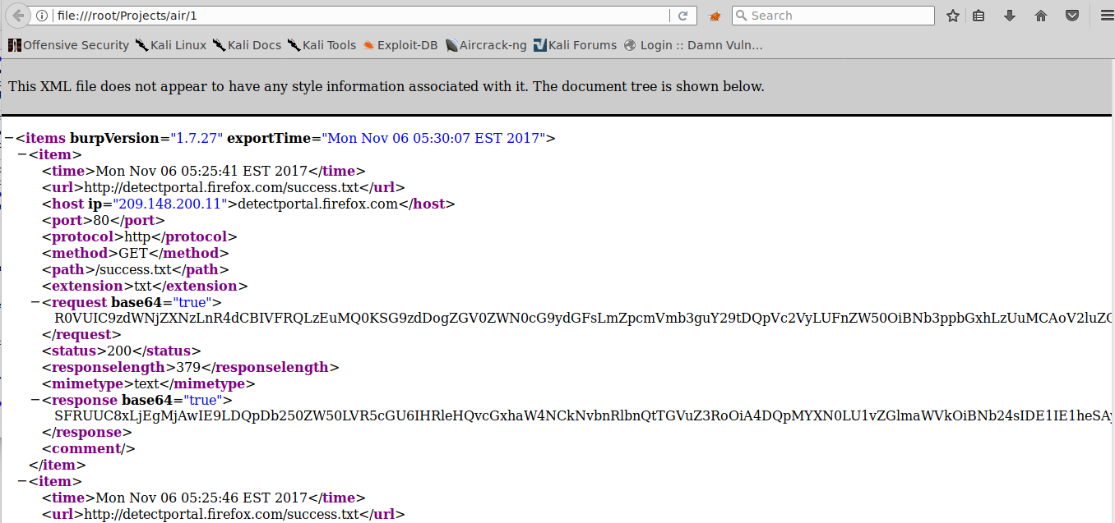
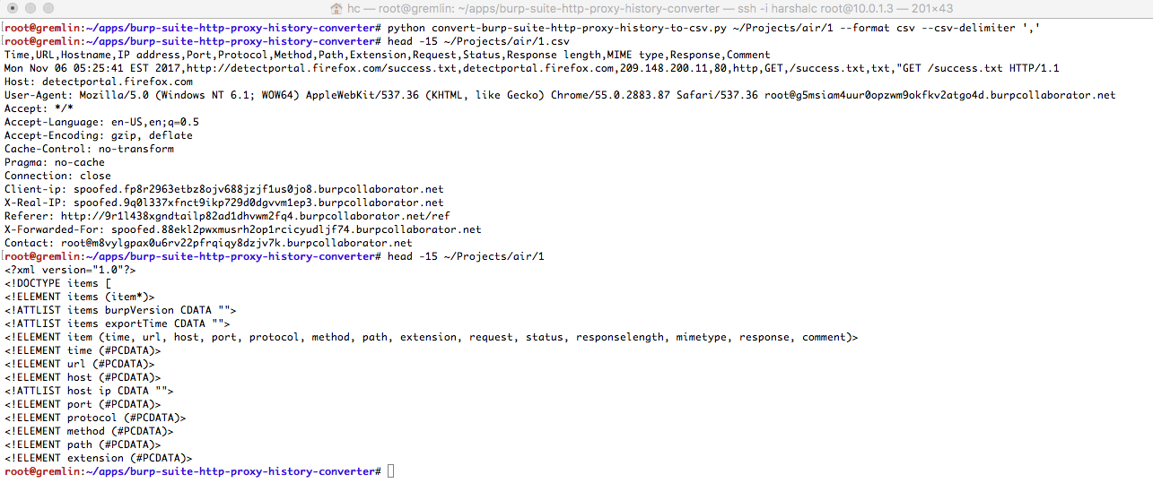
Log Extraction

Slide 23
Questions and Takeaways
Burp History Converter -> https://github.com/mrts/burp-suite-http-proxy-history-converter
Payloads (xss | passwords | directory busters | and more...) -> https://github.com/foospidy/payloads
CORS -> https://www.geekboy.ninja/blog/exploiting-misconfigured-cors-via-wildcard-subdomains
Pentest Resources (web report tracking | database | checklists) -> http://harshdevx.com/codex/ptest.zip
General reading -> http://www.adeptus-mechanicus.com/learn/nwadden.php
General reading -> http://www.adeptus-mechanicus.com/learn/harshalc.php
General reading and download resources -> http://harshdevx.com
OWASP Top Ten -> https://www.owasp.org/index.php/Category:OWASP_Top_Ten_Project
Burp Suite Support Centre -> https://support.portswigger.net/
DVWA -> https://github.com/ethicalhack3r/DVWA
Multiladae -> https://sourceforge.net/projects/mutillidae/
Metasploitable -> https://sourceforge.net/projects/metasploitable/files/Metasploitable2/
SANS -> https://sans.org
Other security resources -> https://www.cisecurity.org/cis-benchmarks/

Slide 24



Thank You
Harshal Chandokar
Natalia Wadden
business.harshal@gmail.com
@harshdevx
ca.linkedin.com/in/harshalchandorkar
wadden.natalia@gmail.com
@nataliawadden
ca.linkedin.com/in/nataliawadden
Notes:
DVWA -> http://www.dvwa.co.uk/
burp history converter -> https://github.com/mrts/burp-suite-http-proxy-history-converter
payloads (xss | passwords | directory busters | and more...) -> https://github.com/foospidy/payloads
cors -> a. https://www.geekboy.ninja/blog/exploiting-misconfigured-cors-via-wildcard-subdomains/
b. https://www.geekboy.ninja/blog/exploiting-misconfigured-cors-cross-origin-resource-sharing/
pentest resources (web report tracking | database) -> http://harshdevx.com/codex/ptest.zip
general reading -> http://www.adeptus-mechanicus.com/learn/nwadden.php
general reading -> http://www.adeptus-mechanicus.com/learn/harshalc.php
general reading and download resources -> http://harshdevx.com
OWASP Top Ten -> https://www.owasp.org/index.php/Category:OWASP_Top_Ten_Project
Burp Suite Support Centre -> https://support.portswigger.net/

